Slide 1
UE22CS320A– Project Phase – 2
Capstone Project –Phase 2 –review 1
Project Title : Detection And Mitigation Of Replay Attacks
Project ID : 49
Project Guide : Dr Sarasvati V
Project Team : Mohit Prasad Singh (PES2UG22CS320)
Shreyas S (PES2UG22CS540)
Soumya Ranjan Mishra (PES2UG22CS571)
Suhas Venkata (PES2UG22CS590)

Slide 2
Agenda
Problem Statement
Abstract and Scope
Suggestions from Phase-1
Requirements Specification
Design Approach
Design Constraints, Assumptions & Dependencies
Proposed System / Approach
Architecture
Design Description
Project Progress
References

Slide 3
Problem Statement
“Replay Attacks on CCTV Systems: A Significant Threat”
CCTV systems are essential for modern surveillance, yet they are vulnerable to replay attacks, where attackers intercept and resend legitimate data, leading to unauthorized actions. These attacks exploit the lack of robust security measures, particularly in communication protocols that fail to implement strong authentication and encryption​.
The consequences can be severe, including unauthorized access, manipulation of recorded footage, and compromised integrity of surveillance data. Industries such as banking and transportation face significant risks, as compromised CCTV can undermine public safety and trust​.
Despite existing security measures, there remains a gap in addressing replay attack vulnerabilities. This project aims to develop an AI-based detection and response system to enhance the security of CCTV networks against these specific threats, ensuring a more reliable surveillance infrastructure

Slide 4
Abstract and Scope
CCTV systems are vital for surveillance across sectors like banking, transportation, healthcare, and public safety. However, they face growing cyber threats, especially replay attacks, where intercepted video or data streams are retransmitted to deceive the system. This leads to unauthorized access, footage tampering, and compromised surveillance integrity, exposing the need for robust security enhancements. This project proposes an AI-based detection and response system to mitigate replay attacks by integrating machine learning and cryptographic security measures.
Key components include:
AI-Powered Anomaly Detection: Identifying timestamp and frame inconsistencies in video streams.
- Secure Communication Protocols: Encrypting data and verifying stream authenticity.
- Real-Time Automated Response: Alerting admins, isolating compromised devices, and blocking threats.
Modular Design: Seamlessly integrating with existing infrastructures. The system undergoes vulnerability assessments, machine learning model training, and rigorous testing to ensure effectiveness, scalability, and ease of use.
Expected outcomes include improved replay attack detection, enhanced CCTV security, and greater trust in surveillance technologies, making this a significant step towards adaptive, secure surveillance solutions.

Slide 5
Suggestions from Phase-1
Look for latest datasets
Find more papers on replay attacks on CCTV cameras

Slide 6
Requirements Specification
Functional Requirements:
Replay Attack Detection:
Real-time Detection: AI algorithms to identify pre-recorded footage.
Pattern Analysis: Detect irregularities in motion, timestamps, and context.
Multi-Source Verification: Cross-check with audio and sensor data.
System Resilience:
Data Security: Use cryptographic techniques to prevent tampering.
Anomaly Alerts: Automated alerts for detected anomalies.
Real-Time Operation:
Low Latency: Ensure immediate response with minimal delay.
Data Handling:
Archiving: Store flagged footage with metadata securely.

Slide 7
2. Non-Functional Requirements:
Scalability:
Multiple Feeds: Support various camera setups and numerous CCTV feeds.
Accuracy:
Detection Precision: Minimize false positives/negatives.
Performance:
Efficiency: Optimized for real-time, high-resolution video.
Security:
Encryption: Secure communication channels and authentication.

Slide 8
1. Technologies to Be Used:
Video Analysis:
OpenCV & Optical Flow Algorithms: For robust motion analysis and irregularity detection.
Deep Learning:
TensorFlow/PyTorch: Detecting replay attacks using pre-trained models (e.g., C3D, 3D-CNN).
Real-Time Pose Estimation:
NVIDIA DeepStream SDK/TRTPose: Detect repetitive movements indicating replay attacks.
Cryptographic Techniques:
Blockchain/SHA-256: Tamper-proof video metadata storage and frame validation.
Sensor Fusion:
PyAudio & NumPy: Cross-check video motion with audio synchronization.
Alerting & Monitoring:
Flask/Django Backend, ReactJS Frontend: Real-time alerts and responsive dashboard.
Video Transmission & Storage:
GDPR Protocol, Microsoft Azure: Efficient streaming and secure archiving.

Slide 9
Hardware Requirements:
Cameras:
Web camera that can send live footages to the system via USB-C.
Processing Unit:
GPU-enabled local system.
Network:
Gigabit Ethernet for fast, secure transmission.

Slide 10
Detection and Mitigation Process:
Video Analysis:
Optical flow analysis to detect motion inconsistencies.
Cryptographic Frame Validation:
Real-time frame hashing to detect tampering.
Anomaly Detection with Deep Learning:
AI models classifying motion patterns as real or replayed.
Mitigation & Alerting:
Flagging suspicious feeds, sending real-time alerts, and switching to backups if tampering is detected.

Slide 11
Design Approach
Modular Design:
Independent modules for video processing, anomaly detection, and cryptographic validation.
Modules communicate through APIs or message brokers.
Why:
Simplifies development and debugging.
Allows easy upgrades or replacements of components.
2. Real-Time Processing:
Optical flow and deep learning models analyze video frames in real-time.
Instantaneous alerts and mitigation actions.
Why:
Real-time detection reduces the window for potential harm from replay attacks.
3. Edge-Cloud Integration:
Local processing at the edge (e.g., on GPU-enabled devices) for latency reduction.
Secure cloud storage for suspicious feeds and metadata.
Why:
Minimizes latency and reduces bandwidth usage.
Enables scalability and centralized monitoring.

Slide 12
Benefits of This Approach
Scalability:
Supports multiple camera feeds and scales with minimal changes.
Cloud integration handles increasing data storage and computational demands.
High Accuracy:
Multi-layered detection minimizes false positives and negatives.
Combining video, audio, and environmental data improves reliability.
Real-Time Performance:
Immediate detection and mitigation reduce the impact of replay attacks.
Alerts allow timely human intervention.
Flexibility and Upgradability:
Modules can be updated or replaced without overhauling the entire system.
Adaptable to evolving threats and new attack vectors.
Security:
Cryptographic validation prevents video frame tampering.
Secure communication protocols protect data in transit.

Slide 13
Drawbacks of This Approach
High Computational Demand:
Real-time processing requires significant hardware resources (e.g., GPUs).
Optical flow and deep learning algorithms are computationally intensive.
Complexity in Integration:
Coordinating multiple detection layers increases system complexity.
Requires sophisticated synchronization to avoid inconsistencies.
False Positives and Negatives:
Subtle replay attacks or non-standard behavior patterns might evade detection.
Initial tuning of thresholds and models can lead to false alerts.
Cost:
Edge devices, GPUs, and secure cloud storage can be expensive for large-scale deployments.

Slide 14
Alternate Design Approaches
Blockchain-Based Verification System:
Hash and log each video frame in a blockchain.
Cross-verify live feed frames with the blockchain ledger.
Benefits:
Immutable, tamper-proof video data record.
Detects replay attacks by identifying frames not in the blockchain.
Drawbacks:
High computational overhead for frequent hashing.
Latency from blockchain transactions.
2. AI-Only Detection System:
Single deep learning model (e.g., hybrid CNN-RNN) detects replay attacks from video patterns.
Benefits:
Simplifies architecture.
Easier to implement and maintain.
Drawbacks:
Reduced accuracy without multi-sensor verification.
Limited robustness against evolving attack strategies.

Slide 15
Decentralized Monitoring System:
Cameras with embedded AI analyze video locally. Results aggregated to detect anomalies.
Benefits:
Reduces reliance on a centralized server.
Increased fault tolerance as cameras operate independently.
Drawbacks:
Lack of centralized control complicates coordination.
Higher hardware costs for embedded AI capabilities.
2. Watermarking-Based Validation:
Embed dynamic, invisible watermarks into live video streams. Verify watermarks in real-time.
Benefits:
Simple, efficient tampering and replay attack detection.
Minimal computational overhead.
Drawbacks:
High-quality editing can remove or mimic watermarks.
Effectiveness diminishes under compression or frame degradation.

Slide 16
Design Constraints
Real-Time Processing:
Requires efficient HTM implementations and low-latency blockchain operations.
Storage and Bandwidth:
Blockchain storage of video hashes grows over time; requires scalable solutions.
Scalability:
Public blockchains face transaction limits; private or hybrid blockchains needed.
Video Chunking Granularity:
Hashing every frame is resource-intensive; chunk-based hashing reduces overhead.
Energy Consumption:
Blockchain consensus mechanisms like PoW are energy-intensive.

Slide 17
Assumptions
Blockchain Immutability:
Blockchain is tamper-proof, ensuring video authenticity.
HTM Accuracy:
HTM effectively detects temporal anomalies.
Computational Resources:
Access to edge devices with GPU capabilities.
Trust in Blockchain Nodes:
Private or hybrid nodes operate in a trusted environment.
Temporal Anomalies in Replay Attacks:
Replay attacks disrupt temporal continuity.

Slide 18
Dependencies
HTM Model Performance:
Accurate learning of normal patterns and anomaly detection.
2. Blockchain Infrastructure:
Efficient logging of video hashes and real-time verification.
3. Hashing Algorithm Robustness:
Use of collision-resistant hashes like SHA-256.
4. Network Connectivity:
Continuous connectivity between edge devices and blockchain nodes.
5. Edge Processing Scalability:
Real-time processing of high-resolution video feeds.

Slide 19
Design Details
Briefly describe all the platforms, systems, and processes that it depends on and comprise any vital changes that need to be made to them.
Below are some examples but it is not an exhaustive list:
Novelty, Innovativeness, Interoperability, Performance, Security, Reliability, Maintainability, Portability, Legacy to Modernization, Reusability, Application Compatibility.
Note: Applicable to Research project

Slide 20
Design Details
Platforms, Systems, and Processes Overview of this project — Detection and Mitigation of Replay Attacks on CCTV Systems—relies on AI-driven scene analysis, HTM-based temporal anomaly detection, cryptographic security, and edge processing to enhance surveillance security.
Key Components and Changes Needed:
Novelty & Innovativeness AI + HTM Hybrid Detection: Detects both spatial and temporal anomalies in video streams.
Blockchain Integrity Checks -> Prevents post-attack tampering.
🔹 Enhancements: Optimize AI models for edge processing; adaptive anomaly thresholds.
2. Interoperability & Performance Compatible with RTSP, ONVIF, and various CCTV systems: Edge processing reduces latency while ensuring real-time detection.
🔹 Enhancements: API integration for seamless camera-to-server communication.
3. Security & Reliability AES encryption + digital signatures secure video streams: Tamper-proof blockchain logs ensure forensic validity.
🔹 Enhancements: Implement resilience mechanisms for auto-failover.

Slide 21
4. Maintainability & Scalability Modular design supports easy updates and cloud integration: Expandable from single-camera to multi-camera deployments.
🔹 Enhancements: Auto-scaling for cloud-based processing; model retraining pipelines.
5. Portability & Reusability Deployable on Linux/Windows, edge devices, and cloud: AI detection + blockchain security can be reused in other fields (e.g., fraud detection).
🔹 Enhancements: Model compression for resource-constrained environments.

Slide 22
Proposed System / Approach
*** Add as many slides as required to cover the following aspects:
Basic Approach and results obtained
Is there a need for changing the approach?
Details of the new approach- benefits/drawbacks

Slide 23
Basic Approach and results obtained
Basic Approach:
Detection:
AI Models: Use Generative Adversarial Networks (GANs) and Convolutional LSTM (ConvLSTM) for real-time detection of replay attacks.
Process: Analyze video feeds frame-by-frame to identify discrepancies and anomalies indicative of replay attacks.
Protection:
Blockchain: Implement blockchain to hash each video frame and store these hashes immutably, ensuring the integrity of the footage.
Encryption: Securely encrypt the hashes before storing them on the blockchain to prevent tampering.

Slide 24
Results Obtained:
Detection Accuracy: Present metrics showing the effectiveness of GAN and ConvLSTM models in detecting replay attacks, including detection rate and false positive/negative rates.
Performance: Highlight the efficiency of real-time processing on the edge device (C-type web camera or existing system).
Security: Demonstrate the robustness of blockchain in maintaining the integrity and authenticity of video footage, showcasing any successful detection of tampering or replay attacks.

Slide 25
Is there a need for changing the approach?
1. Resource Intensity:
Discuss the computational demands of GAN and ConvLSTM models, and whether they are manageable with your current hardware.
2. Scalability Concerns:
Evaluate if the current approach can scale to larger systems with multiple cameras without significant performance degradation.
3. False Positives/Negatives:
Address any observed issues with false detections and their impact on system reliability.

Slide 26
Details of the new approach - benefits/drawbacks
Hybrid Anomaly Detection System:
Combine HTM for temporal anomaly detection with spatial analysis techniques (e.g., deep learning models for object detection).
Benefits:
- Enhanced accuracy by detecting both temporal and spatial anomalies. - Improved robustness against sophisticated replay attacks.
Drawbacks:
Increased computational requirements.
Need for integration between HTM and deep learning frameworks.
Optimized Blockchain Infrastructure:
- Use lightweight consensus mechanisms (e.g., Proof-of-Authority or Proof-of-Stake) to reduce blockchain overhead. - Implement batch hashing to process video chunks instead of individual frames.
Benefits:
Reduced computational and storage requirements.
Improved scalability for large-scale deployments.
Drawbacks:
- Potential trade-off in detection granularity.

Slide 27
3. Edge-Cloud Collaboration:
Perform HTM-based anomaly detection at the edge for real-time response.
Offload blockchain logging and deep learning-based spatial analysis to the cloud.
Benefits:
Reduced latency for real-time detection.
Offloading heavy computation to the cloud improves edge device efficiency.
Drawbacks:
- Dependence on reliable network connectivity.

Slide 28
Architecture
Provide high-level design view of the system.
Identify the logical user groups, application components, data components, and interfacing systems. Illustrate the collaboration and interaction between the major components.

Slide 29
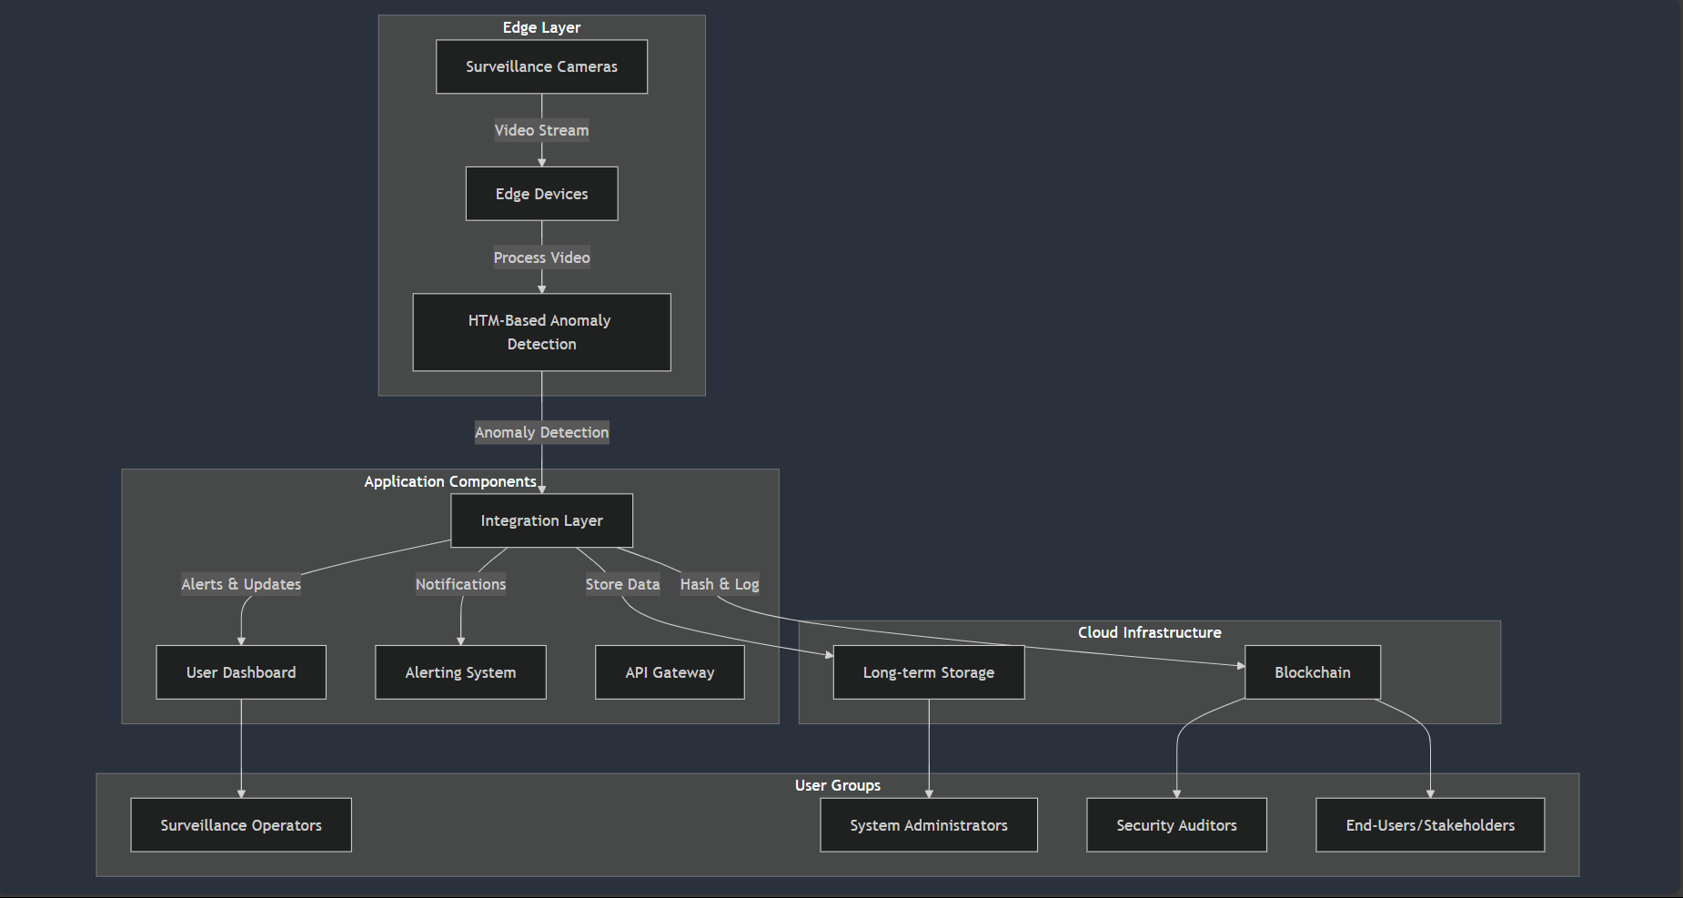
High-Level Design

Slide 30
Design Description
Add as many slides as required to cover the following aspects:
Master class diagram
ER Diagram
User Interface Diagrams/ Use Case Diagrams
External Interfaces

Slide 31
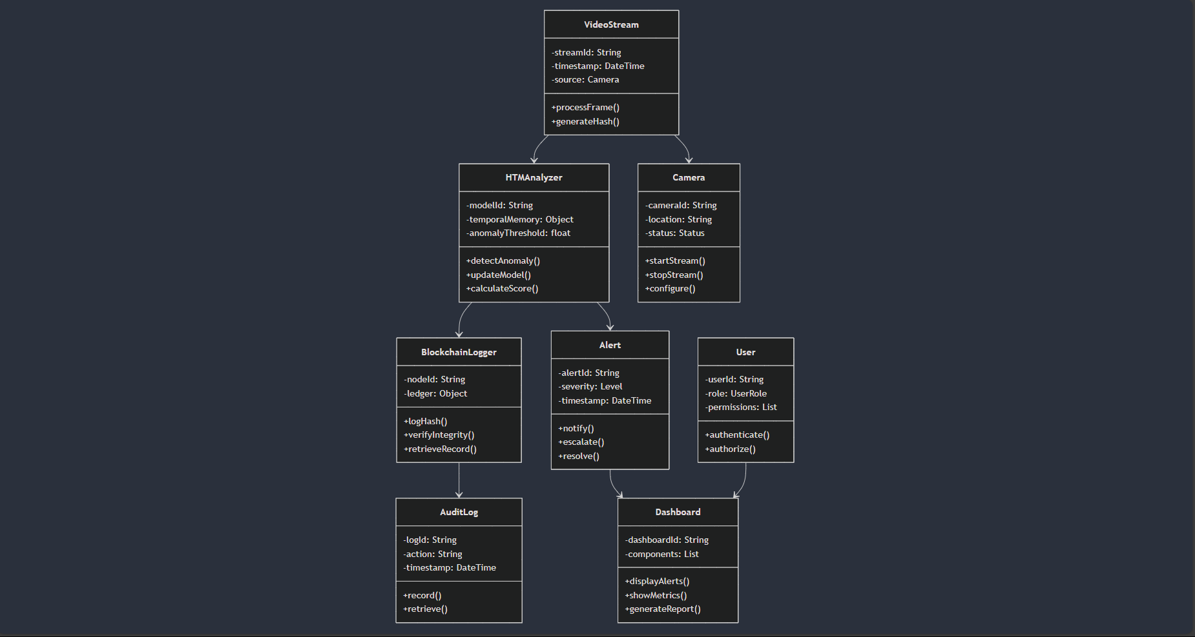
Master class diagram

Slide 32
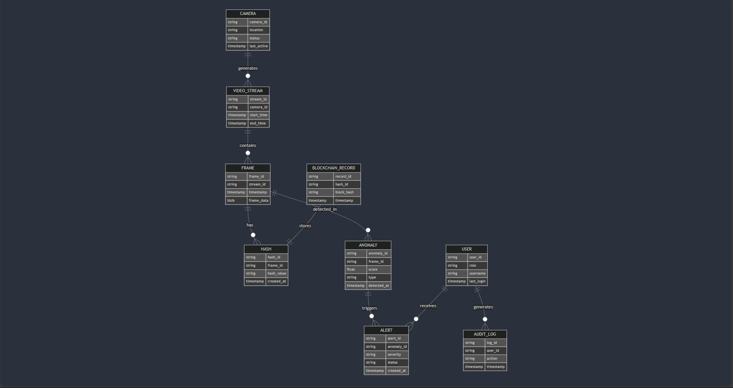
ER Diagram

Slide 33
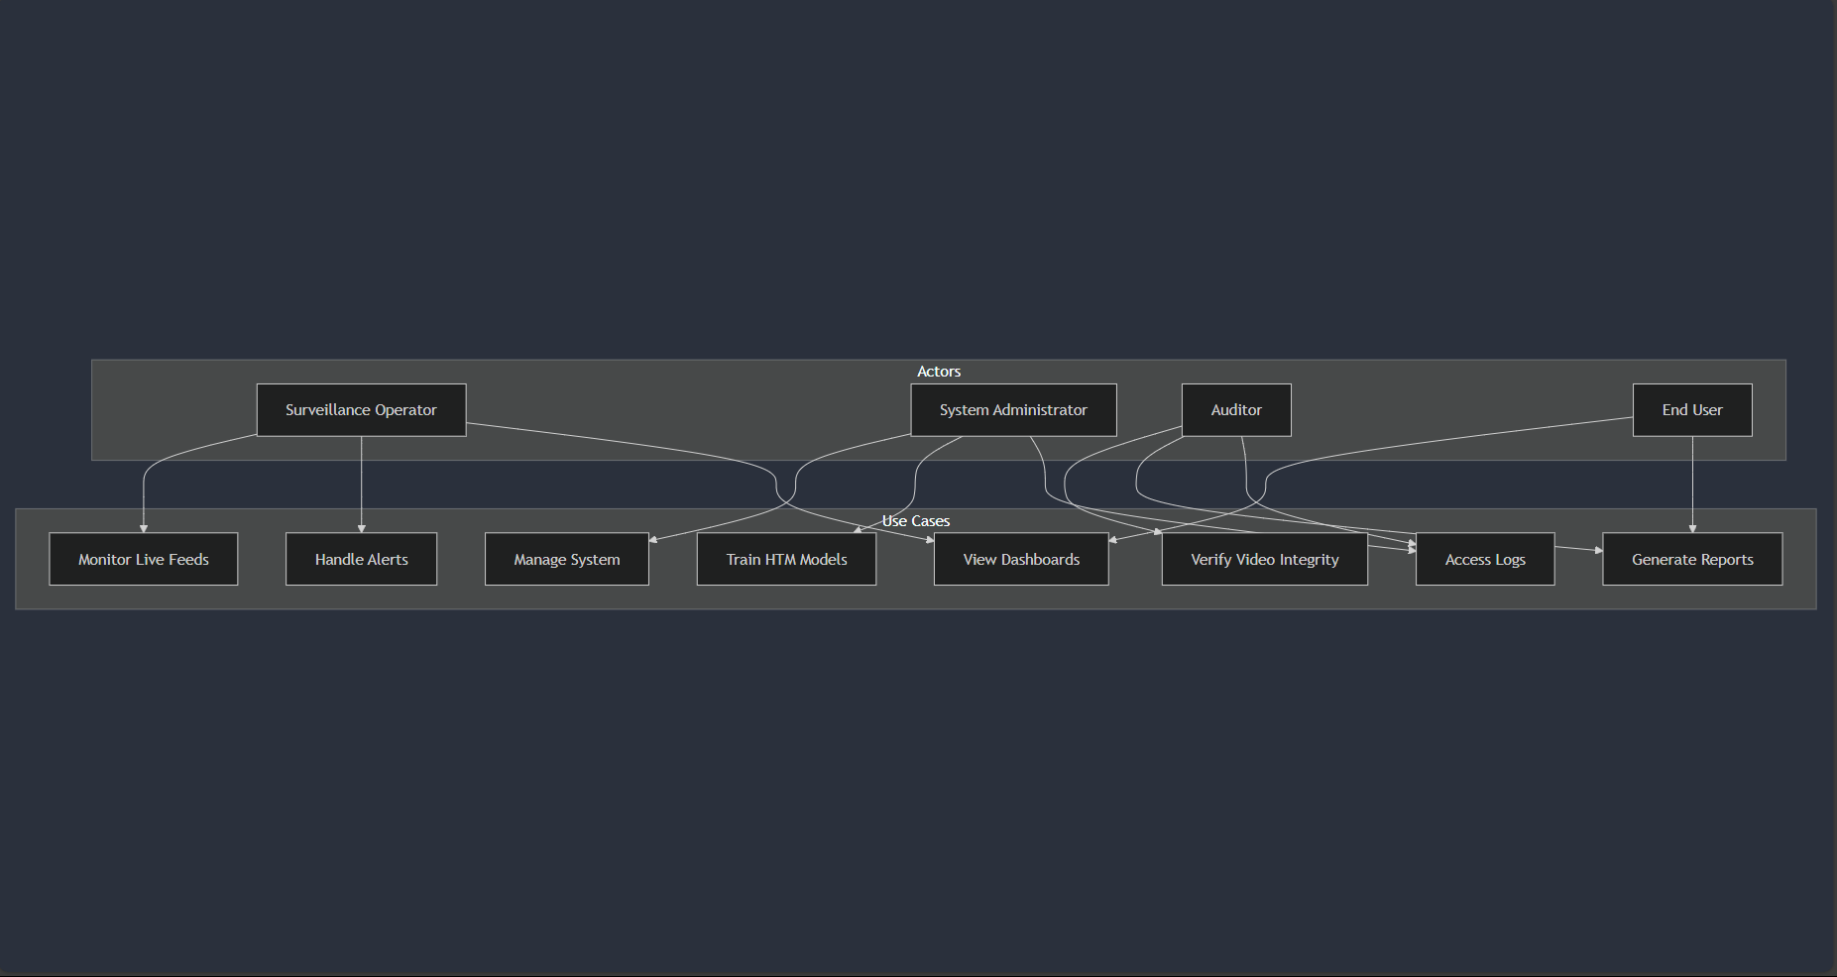
USER INTERFACE DIAGRAM

Slide 34
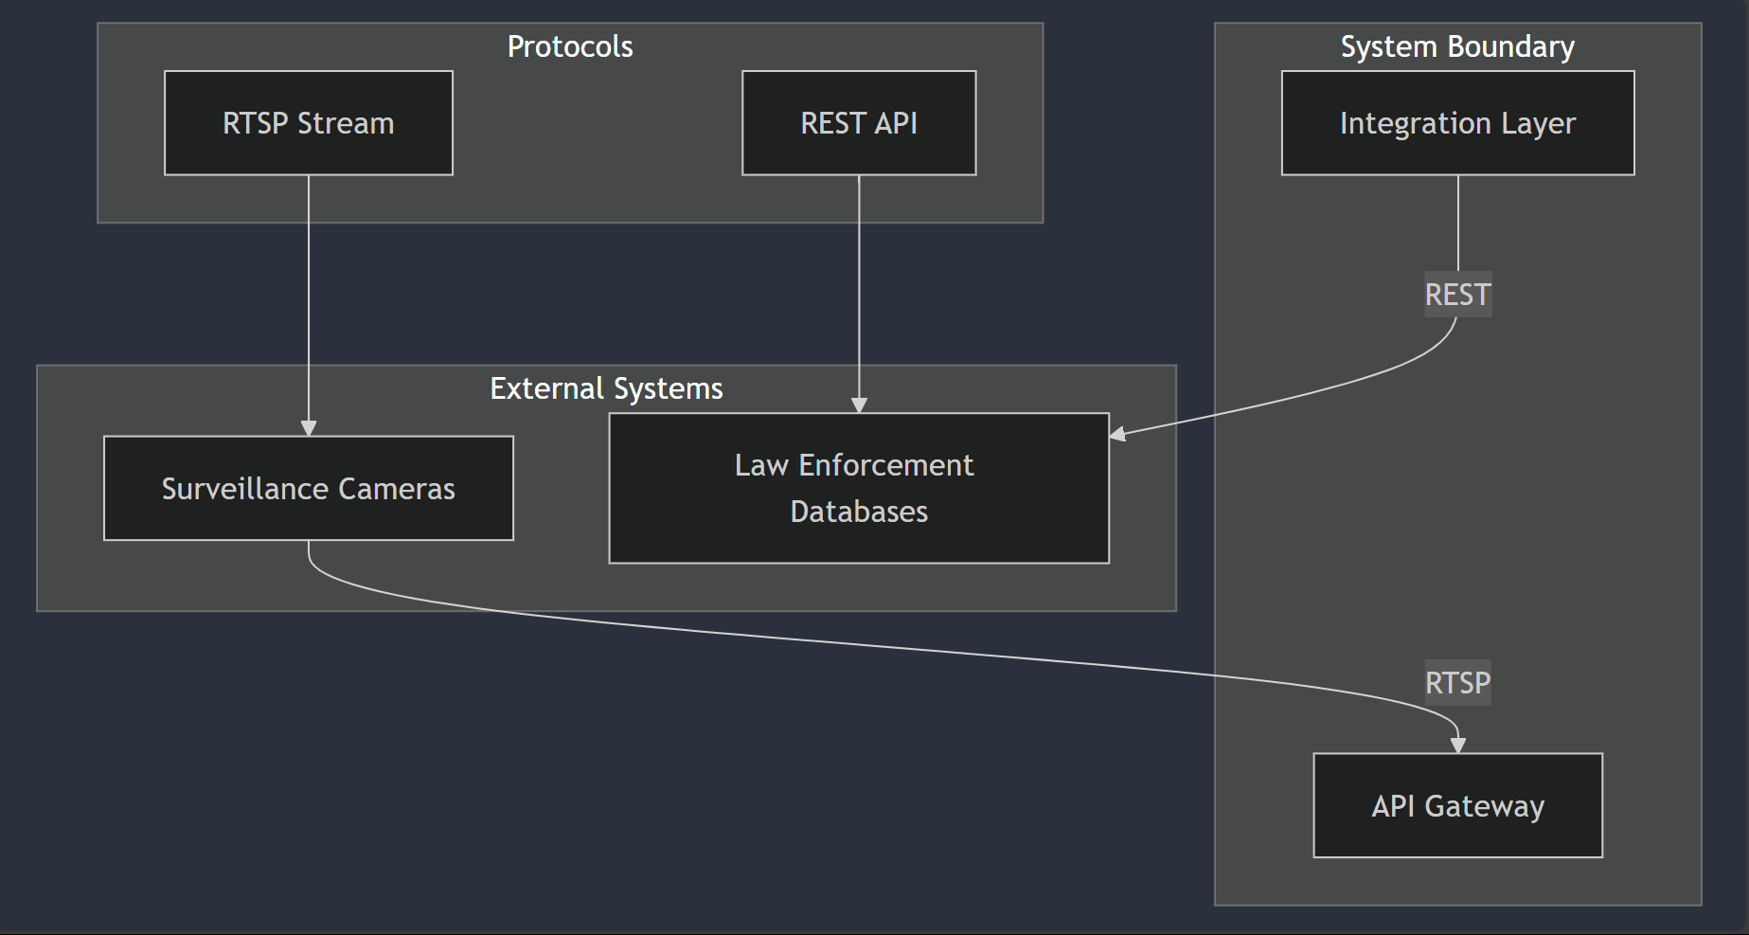
External Interfaces

Slide 35
Capstone (Phase-I ,Phase-II and phase -III) Project Timeline
Provide
The timelines for execution of the project through Gantt chart.
The plan in terms of efforts by individuals in the team.
Mention the tasks involved in different stages.

Slide 36
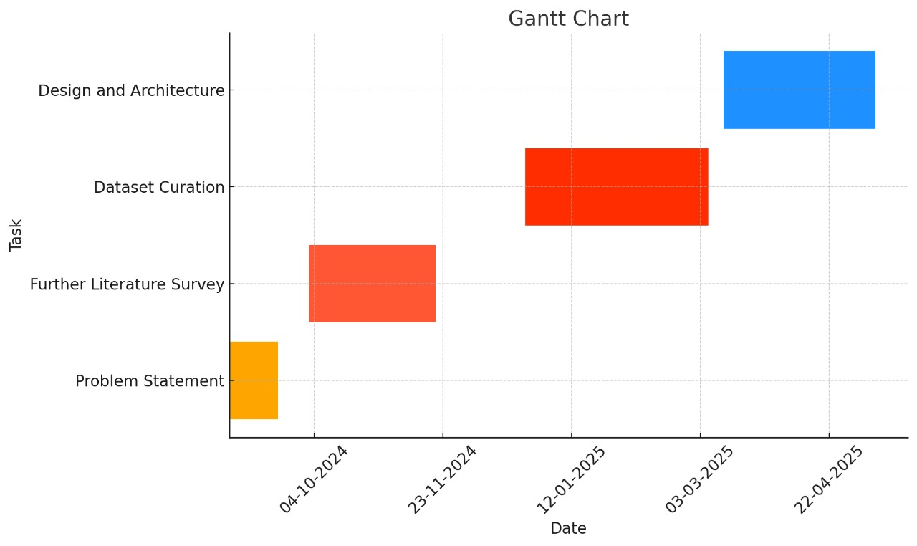
Capstone (Phase-I , Phase-II and Phase III) Project Timeline

Slide 37
Expected Deliverables
Capstone-I deliverables
Capstone-II deliverables
Capstone-III deliverables

Slide 38
CAPSTONE I - Deliverables
Literature survey
Identification of Problem Statement
Requirements Elicitation
Feasibility Study
Setting up a project timeline using Gantt chart
Creating a summary presentation of our idea

Slide 39
CAPSTONE II – DELIVERABLES
Acquiring/Creating relevant datasets
Choosing the appropriate software tools that will be used for the project
Creating a detailed workflow
Creating a prototype based on the datasets collected
High-Level Design

Slide 40
CAPSTONE III – DELIVERABLES
Refining the project prototype and aligning it with industry level standards.
Summing our project along with all the issues resolved that we had come up in Capstone phase II.
Working in the commercial aspect of our project.
Low-Level Design, Module wise implementation
Making a research paper on our project and publishing it.

Slide 41
TENTATIVE EFFORT TO BE CARRIED OUT BY EACH TEAMMATE
Team Member 1:
Data Preparation and Simulation
Responsibilities: Gather and preprocess datasets for training the AI model, focusing on both normal and replay attack scenarios. Set up a simulated CCTV network environment using tools like GNS3 or Cisco Packet Tracer. Simulate network traffic to mimic real-world conditions and replay attack scenarios.
Key Tasks: Identify relevant datasets or create synthetic Datasets. Document the simulation setup process for later integration with the AI model.

Slide 42
Team Member 2:
AI Model Development
Responsibilities: Select appropriate machine learning algorithms for detecting replay attacks. Develop and train the AI model using the prepared datasets. Implement features for anomaly detection based on identified behaviors associated with replay attacks.
Key Tasks: Experiment with different algorithms (e.g., decision trees, neural networks) to find the most effective for our use case. Document the training process, including evaluation metrics and model performance.

Slide 43
Team Member 3:
System Integration
Responsibilities: Integrate the trained AI model with the simulated CCTV network. Ensure the model can analyze video streams and network traffic in real-time for replay attack detection. Develop the interface for the automated response system to be triggered when a replay attack is detected.
Key Tasks: Work on coding the integration between the AI model and the CCTV simulation. Test the system’s functionality to ensure smooth communication between components.

Slide 44
Team Member 4:
Testing and Validation
Responsibilities: Conduct comprehensive testing of the integrated system to evaluate performance, accuracy, and robustness against replay attacks. Gather user feedback (if applicable) and iteratively refine the system based on test results. Prepare detailed documentation of the testing process, outcomes, and system performance metrics.
Key Tasks: Create a testing framework to simulate various replay attack scenarios. Analyze the results and make recommendations for system improvements based on findings.
Collaboration-
Regular Check-Ins: Hold weekly meetings to share progress, troubleshoot issues, and adjust responsibilities as needed.
Shared Documentation: Use a collaborative platform (e.g., Google Docs) to maintain documentation on each aspect of implementation, allowing for easy updates and access.

Slide 45
Any other information
Provide any other information you wish to add on.
Note: Changes can be made in the template, with the consent of the guide for inclusion of any other information.

Slide 46
Any other information
User Training: Educate the personnel who will be interacting with the CCTV system about the signs of replay attacks and how to respond to alerts.
Incident Response Plan: Develop a detailed incident response plan to handle detected replay attacks efficiently. This should include steps for isolating affected systems, investigating the breach, and mitigating the damage.
Redundancy and Backup: Implement redundancy in your CCTV infrastructure to ensure there is always a backup in case one system fails. Regular backups of footage can also help verify the integrity of the data.
Detailed Documentation: Maintain comprehensive documentation of the system design, protocols, and updates. This can help in troubleshooting and training new team members.
User Feedback Loop: Incorporate a feedback mechanism where users can report any false positives or system issues, which can be used to improve the AI model.

Slide 47
Conclusion

Slide 48
References
Provide references pertaining to your research according to IEEE format.

Slide 49
Thank You

